Slide 1

Face recognition
Siamese network
deeplearning.ai

Slide 2
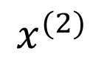

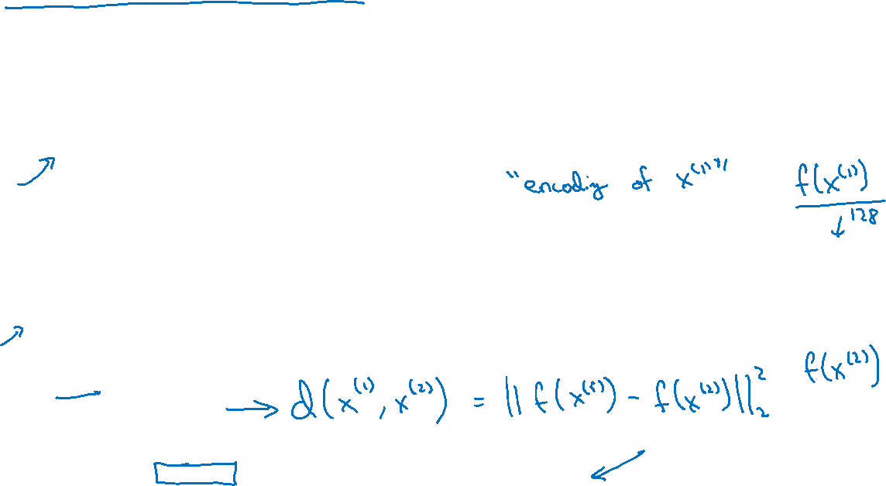
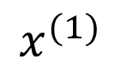
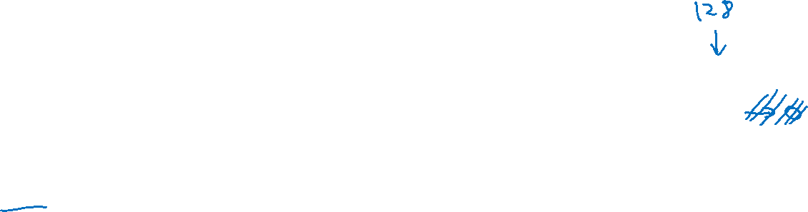
Siamese network
$$⋮$$
$$⋮$$
$$x^{(1)}$$
$$⋮$$
$$⋮$$
$$x^{(2)}$$
[Taigman et. al., 2014. DeepFace closing the gap to human level performance]

Slide 3
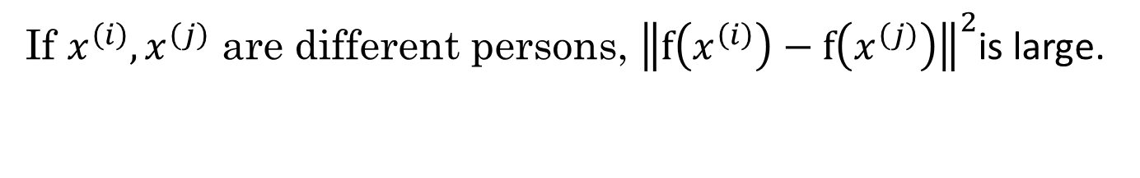
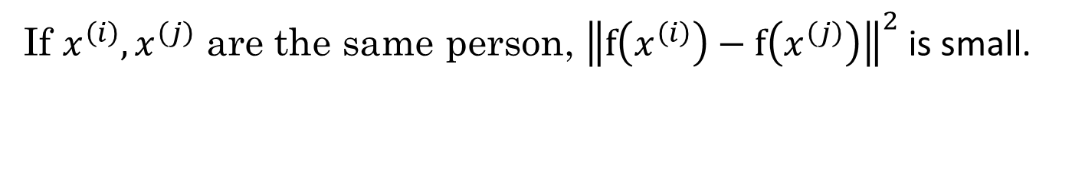
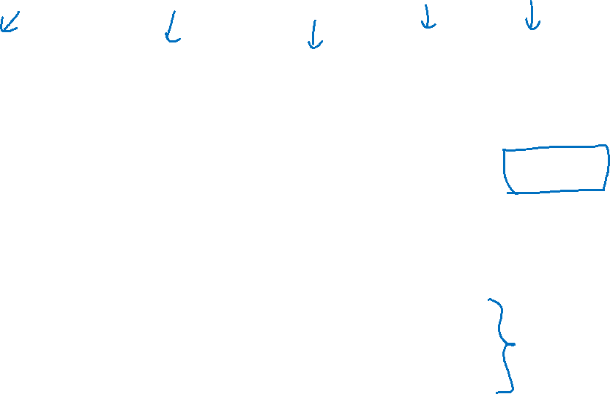
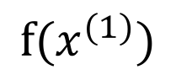

Goal of learning
$$⋮$$
$$⋮$$
$$f(x^{(1)})$$
Parameters of NN define an encoding $f(x^{\left(i\right)})$
Learn parameters so that:
If $x^{\left(i\right)},x^{\left(j\right)}$ are the same person, ${\left\|f\left(x^{\left(i\right)}\right)−f\left(x^{\left(j\right)}\right)\right\|}^{2}$ is small.
If $x^{\left(i\right)},x^{\left(j\right)}$ are different persons, ${\left\|f\left(x^{\left(i\right)}\right)−f\left(x^{\left(j\right)}\right)\right\|}^{2}$is large.

